Slide 1



August 2023
Bond Program
Election Day: August 8, 2023

Slide 2

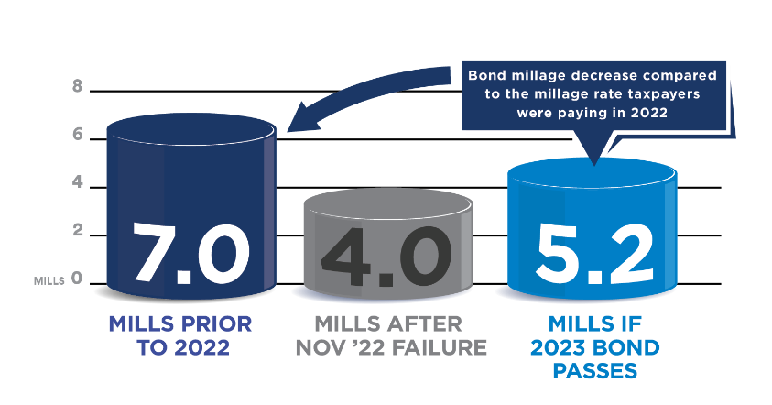
What’s on the August 8, 2023 Ballot?
Total Bond Proposal is $39 million
Touches every facility in the District
Emphasis on safety & infrastructure
Tax Impact = 1.2 mill increase

Slide 3




2023 Bond Goals
Safety & Security
Fiscal Responsibility
Strategic Plan for Student Success
Unified Lakewood Campus

Slide 4
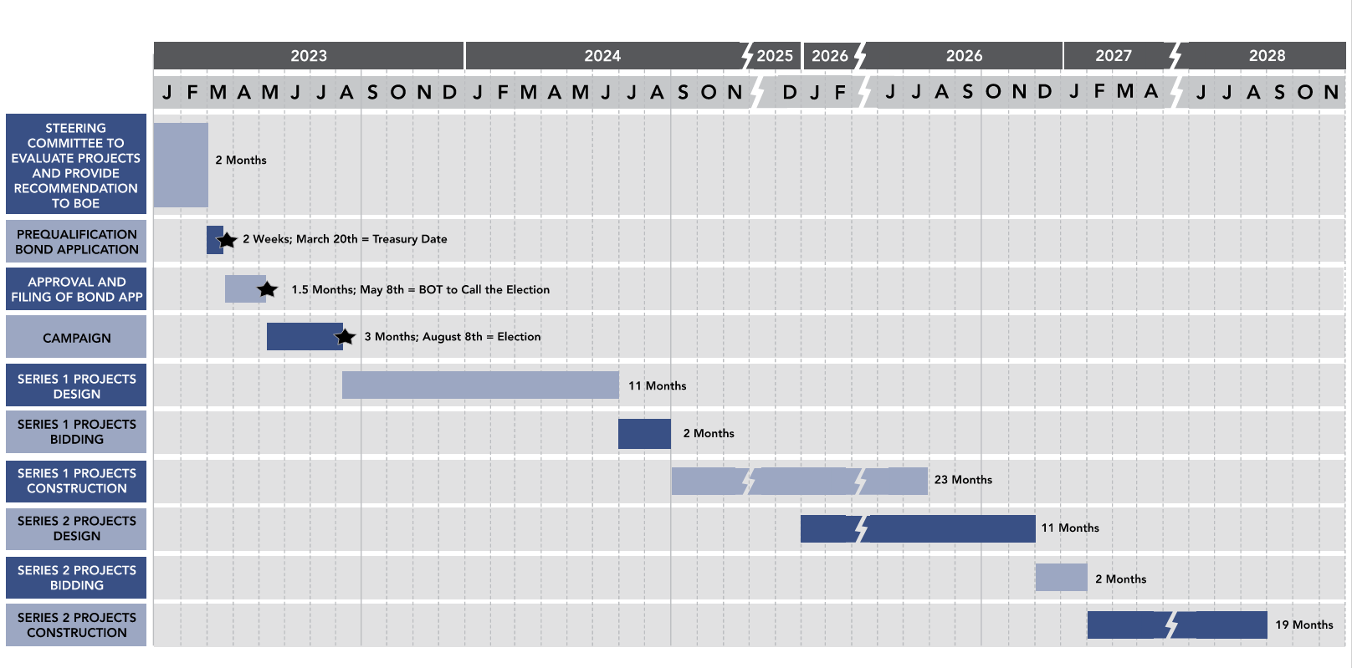
Review Tentative Schedule
Design, Bidding & Construction Phases are just indicative, and will be adjusted based on the potential projects' selection.

Slide 5
Fresh Start – December 2022
  New, 20-Member Steering Committee Formed
Nick Chase
Maintenance Director, community member
Mike Beach
Technology Director, community member, parent
Jodi Duits
Interim Superintendent, community member, parent
Shari Clark
Community member, parent
Dan Dutkiewicz
Community member, parent
Michael Haskin
Citizens Election Committee, Community member, parent
Zack Woodman
Citizens Election Committee, Community member, parent, LEF board member
Chad Hickey
Citizens Election Committee, Community member, parent, LEF board member
Josh Case
Citizens Election Committee, Community member, parent
Tim Brodbeck
Community member
Jamie Brodbeck-Krenz
BOE President, Community member, parent
Wendy Behrenwald
BOE, Community member, parent
Paige O’Mara
BOE, Community member
Abby Thelen
LECC staff member, Community member, parent
Kristi Langmaack
LES staff member, Community member, parent
Tammy Marriott
LMS staff member, Community member
Brie Guiles
LHS staff member, Community member, parent
Don Hoaglin
LECC Principal and Grant Writer
Tim Spitzley
Community member, LEF board member
Nancy Batdorff
Director of Transportation, Community member
Notes:
Reference the role these people play in our community

Slide 6
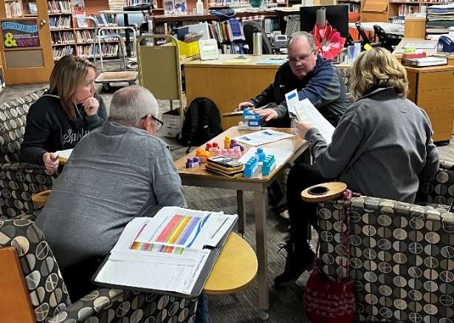
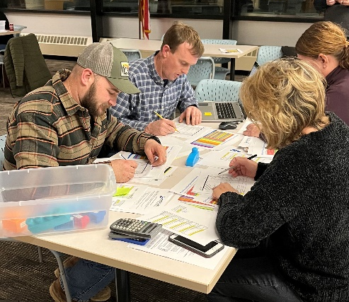
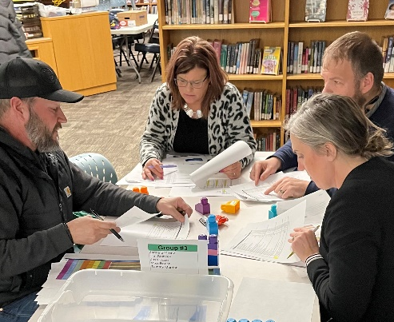
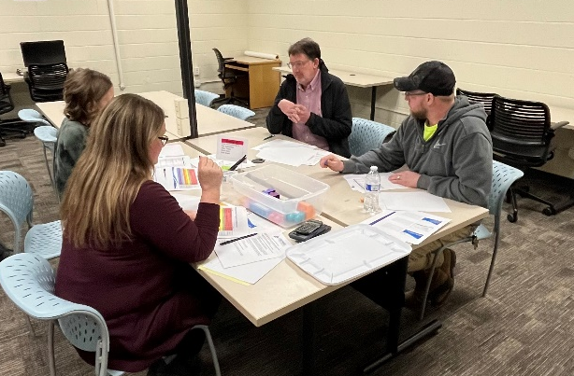
Steering Committee’s Charge
To critically interpret information and bring consensus to a strategic plan for upgrading educational facilities, secure & welcoming entrances, and learning environments that foster a culture of academic excellence and workforce readiness, where all students become lifelong learners.
The Committee will work toward developing a bond program recommendation at the conclusion of their analysis process for the Board of Education’s consideration.

Slide 7
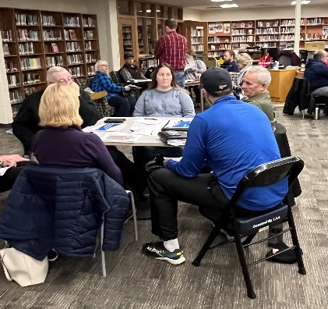
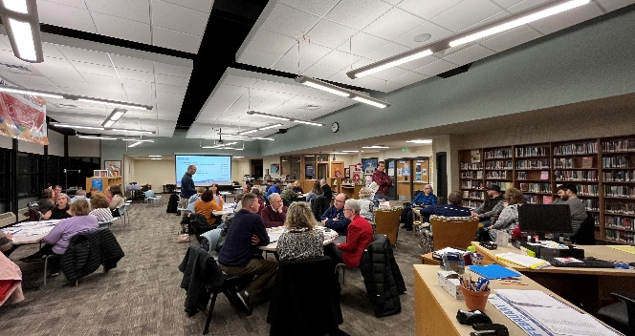
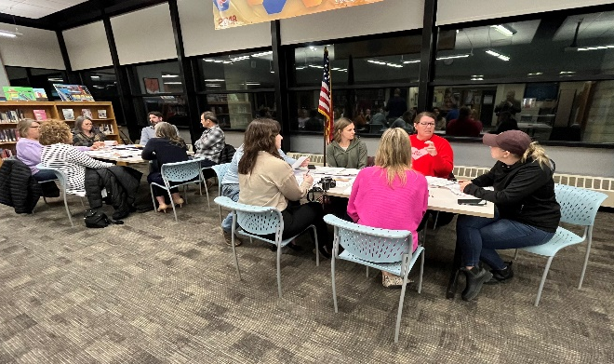
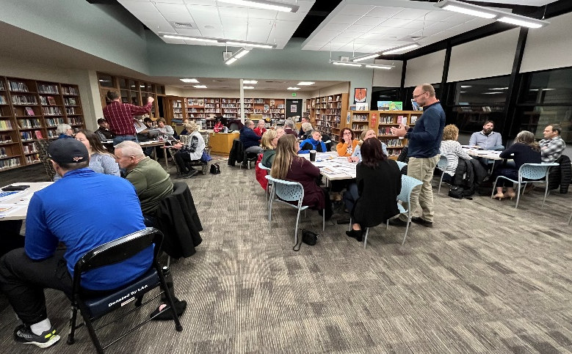
Board of Education & Community Work Sessions
  January 12, 2023
  February 8, 2023
    Community Feedback
    Work session

Slide 8
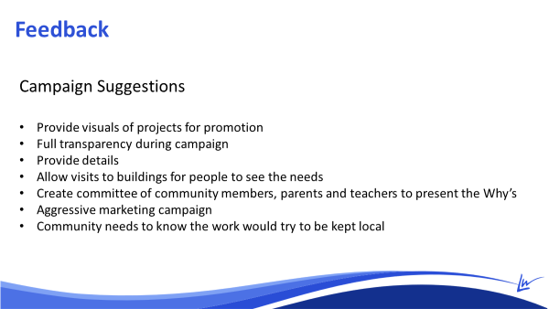
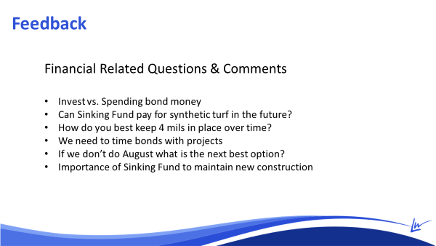
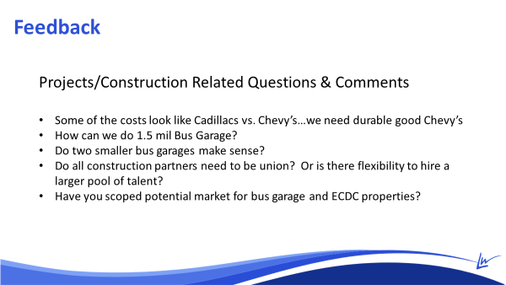
Feedback from Board of Education Work Session

Slide 9
Recommendation to the Board
August 8, 2023 Ballot Initiative for
$ 39 million bond
Two Series
  Series 1 (2023) $ 20 million
  Series 2 (2026) $ 19 million
December 2022 millage dropped from 7 mills to 4 mills
This bond program will increase the current millage rate from 4 to 5.2 mills
Scope of the Bond Program includes:
  Property purchase for a New Facility
  New Buses
  Priority 1 Needs High School, Middle School and Elementary School
  Middle School Roof Replacement and Parking lots
  New Bus Garage
  Relocate Admin to HS (AD Area)
  New Facility, including Fire Pump & Storage Tank
  Technology Upgrades
  New Furniture

Slide 10
Summary of Bond Program Components

Slide 11
Safety & Security

Slide 12
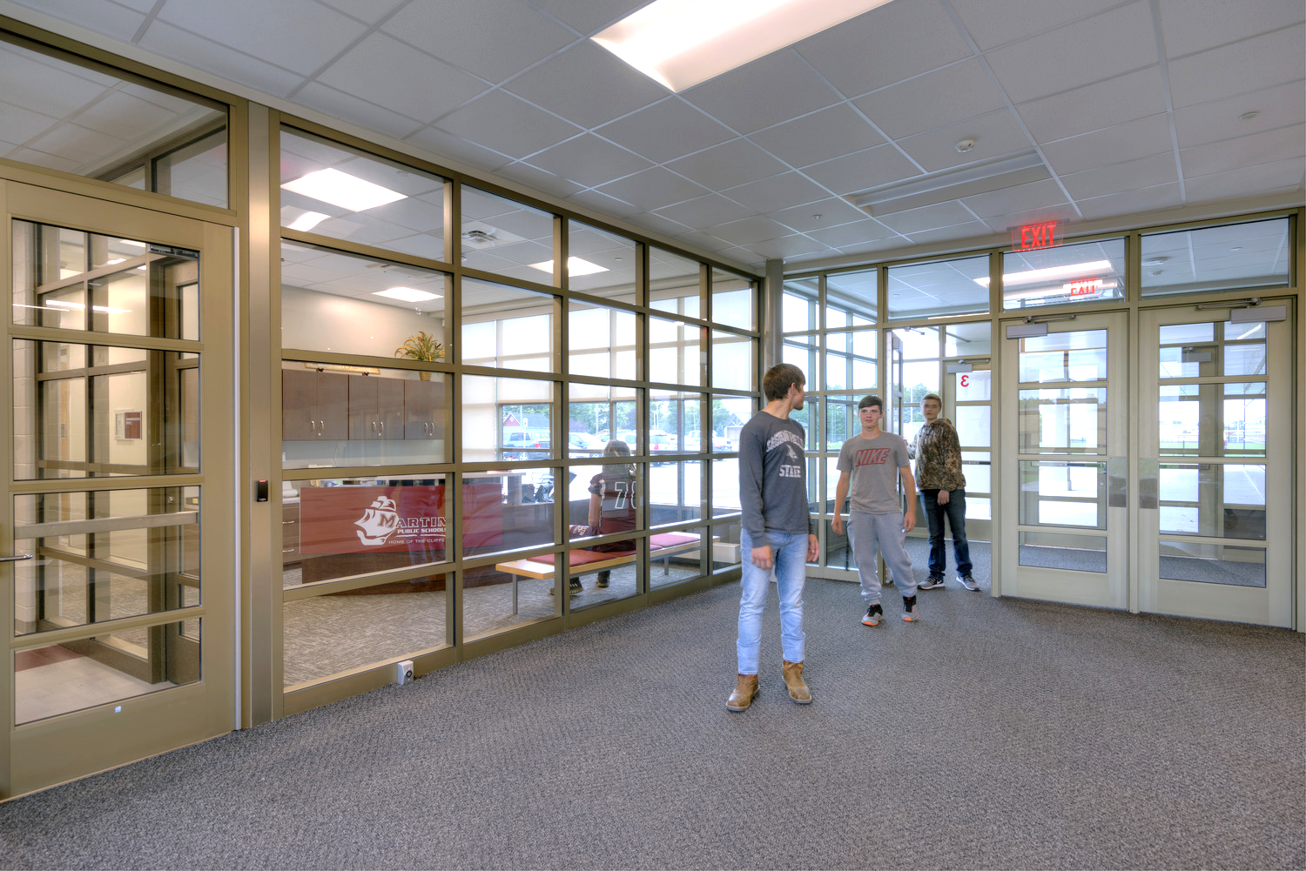
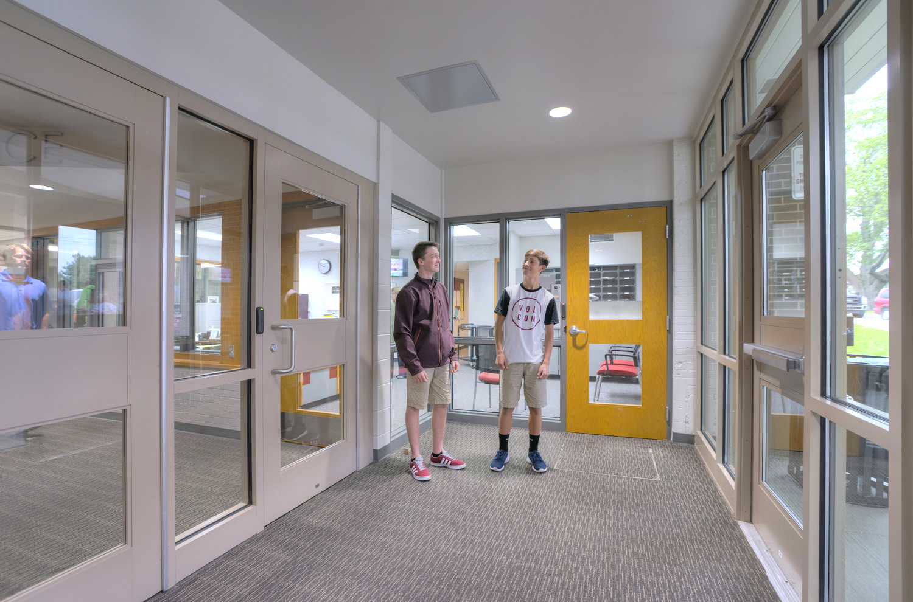
New Safe & Secure Entry

Slide 13
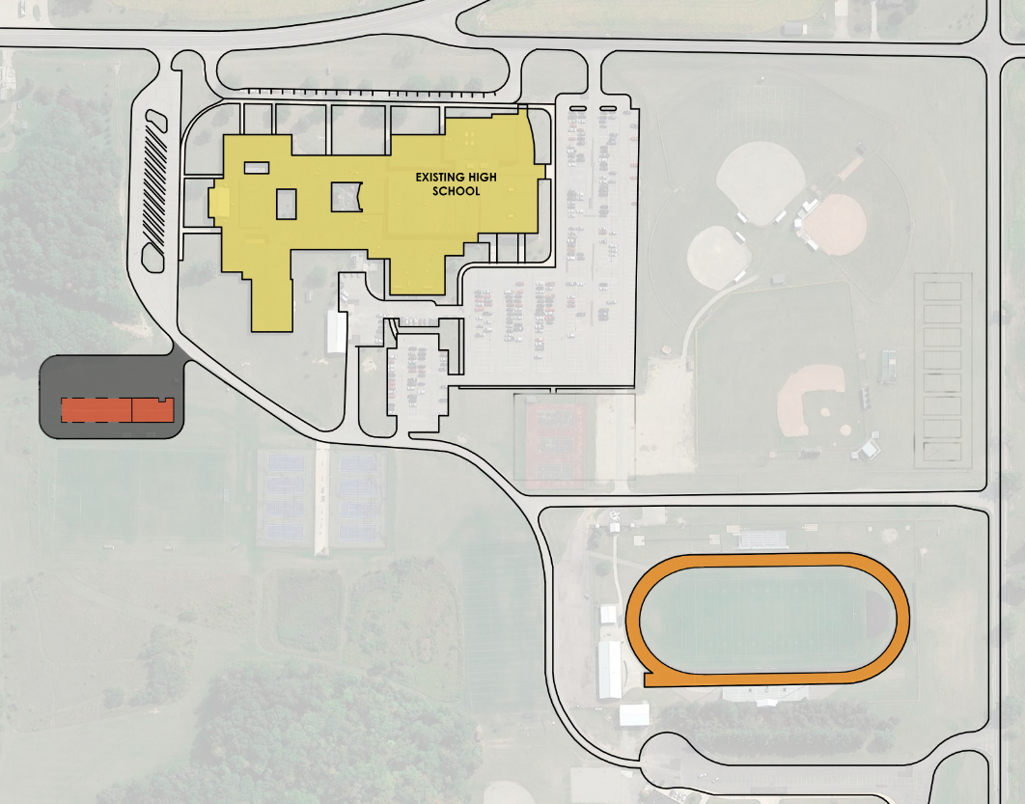
High School Track & New Bus Garage
Potential Location of a New 5,000sf
Bus Garage
Track Replacement
New Fencing
around Track
Notes:
Grass not turf!!

Slide 14
Fiscal Responsibility

Slide 15
High School Infrastructure Needs
Priority 1
1 | Safe and secure entrance
2 | Exterior door security/card access
3 | Secure entry to 2nd floor weight room
4 | Partial roof replacement
5 | Replace fire alarm system
6 | Replace boilers
7 | Replace existing access controls throughout building
8 | Hazardous material removal

Slide 16
Middle School Infrastructure Needs
Priority 1
1 | Safe and secure entrance
2 | Replace fiberglass/skylight roofing in main entry & corridor
3 | Replace HVAC chiller & tower
4 | Replace one boiler
5 | Replace CHW pumps
6 | Replace data cabling throughout building
7 | Tuckpoint masonry in gym
8 | Replace exterior lighting controls

Slide 17
Elementary School Infrastructure Needs
Priority 1
1 | Safe and secure entrance
2 | Replace fire alarm system
3 | Replace chiller
4 | Partial roof replacement
5 | Install additional cameras/surveillance on interior and exterior
6 | Replace concrete/sidewalk entrance at SW corner of building

Slide 18
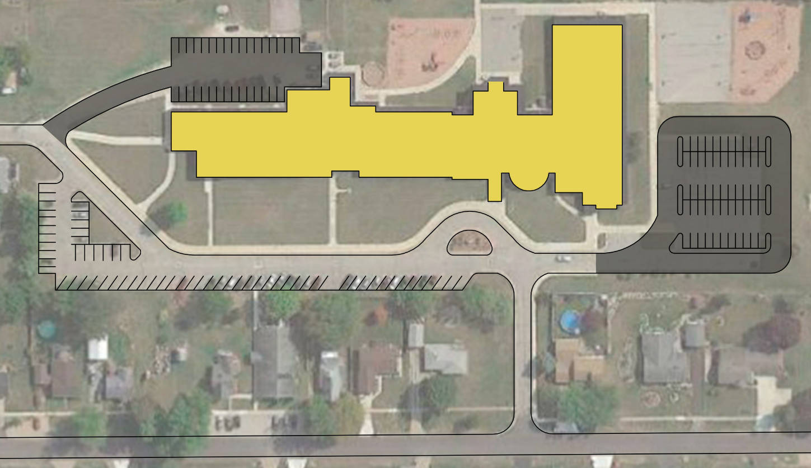
Elementary School New Drives & Parking Lots

Slide 19
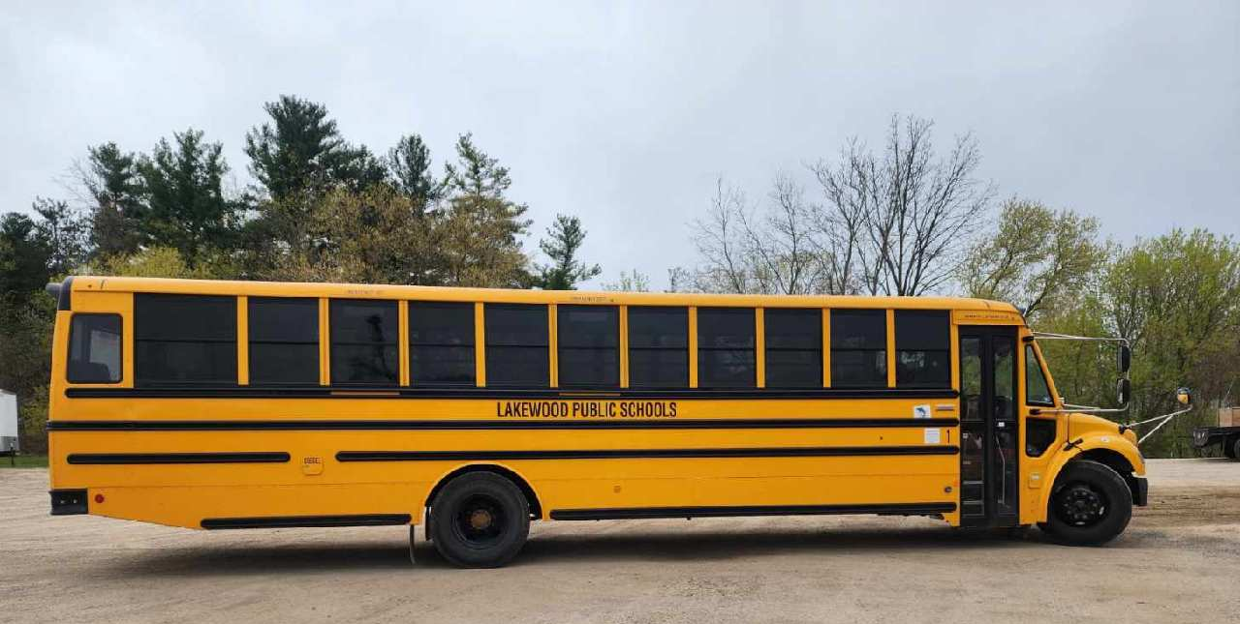
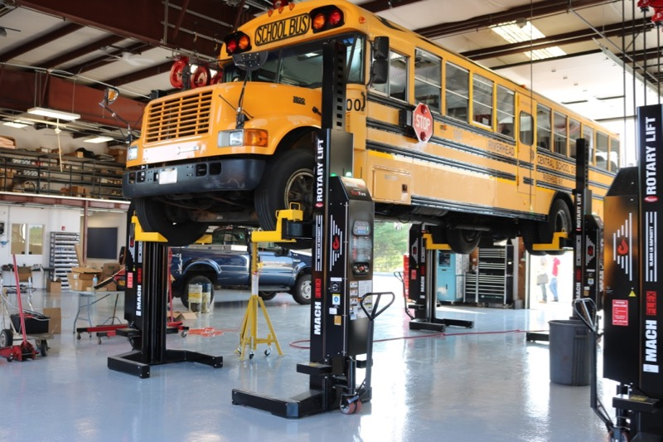
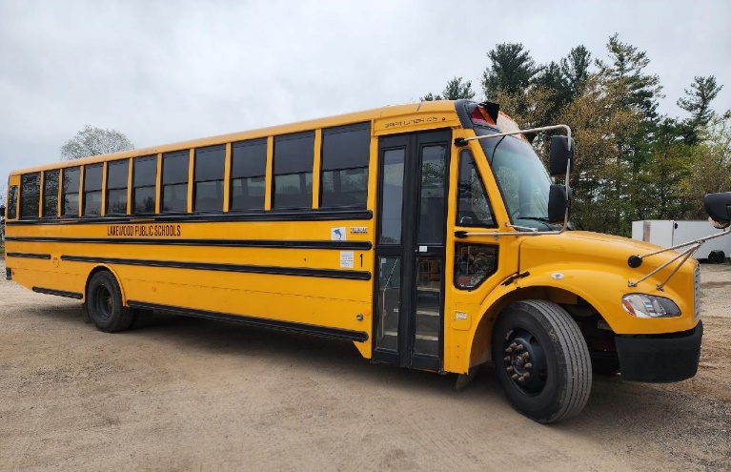
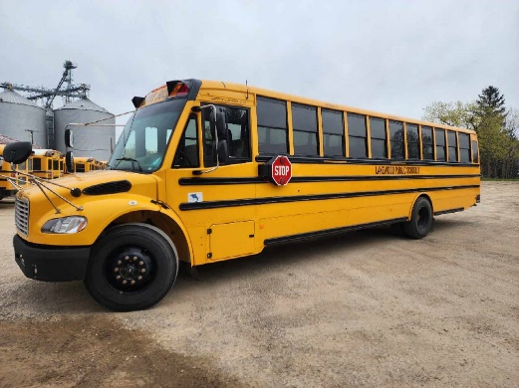
Purchase of Buses
Notes:
Statement from Transportation Director?

Slide 20
Strategic Plan for Student Success

Slide 21
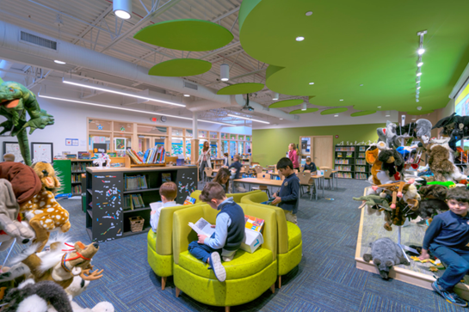
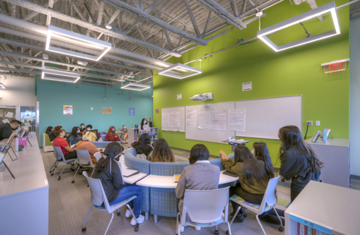
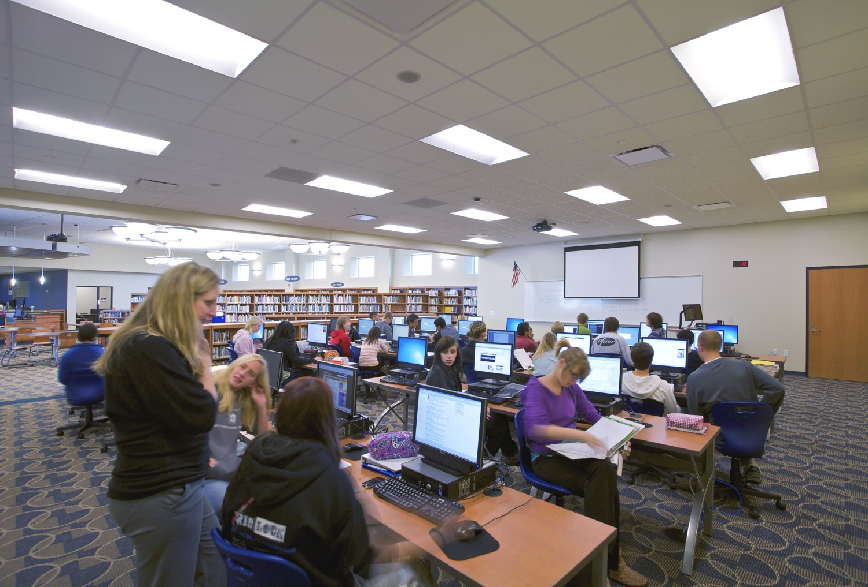
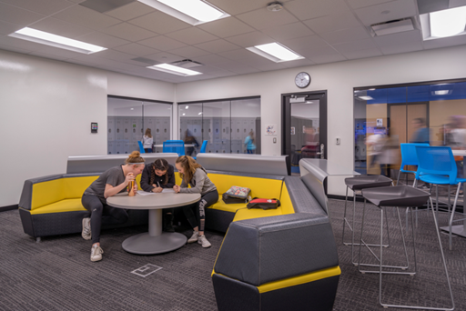
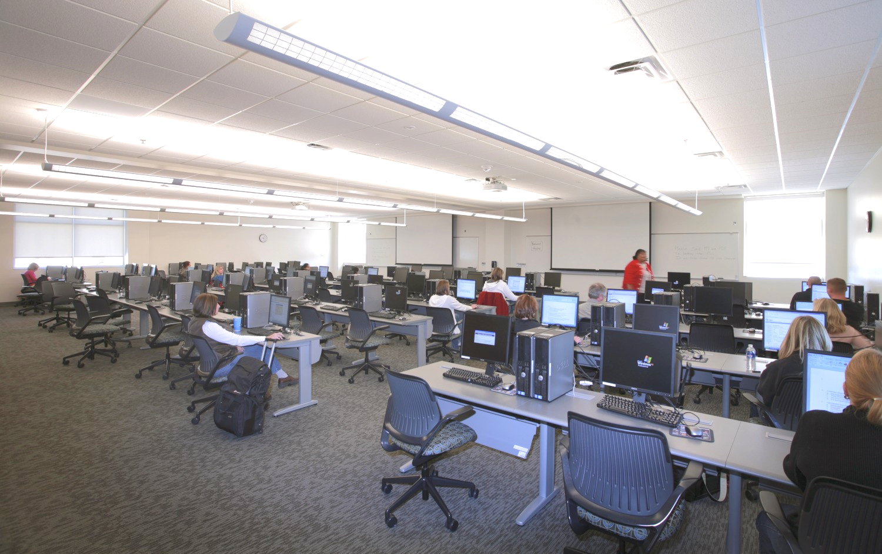
Technology Upgrades & New Furniture

Slide 22
Unified
Lakewood Campus

Slide 23
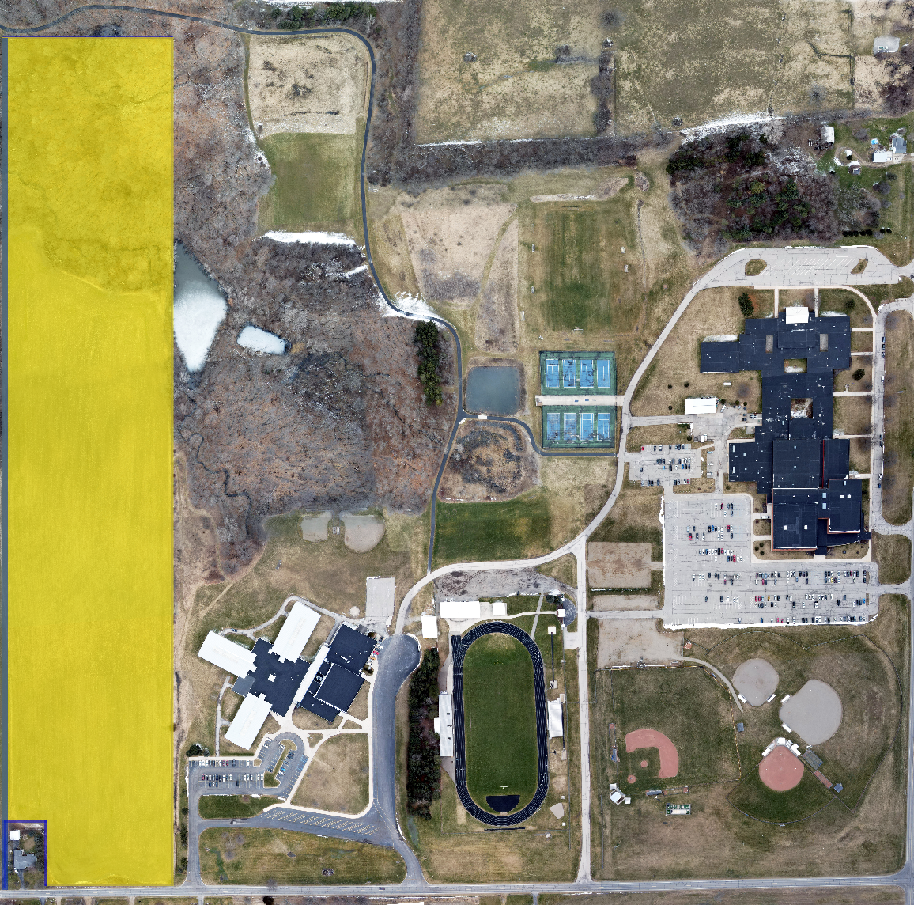
New Property by
Middle School Site

Slide 24
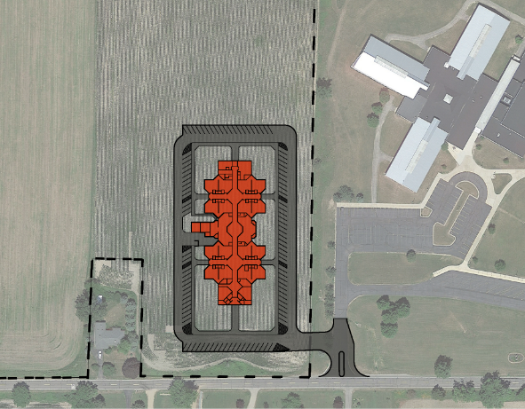
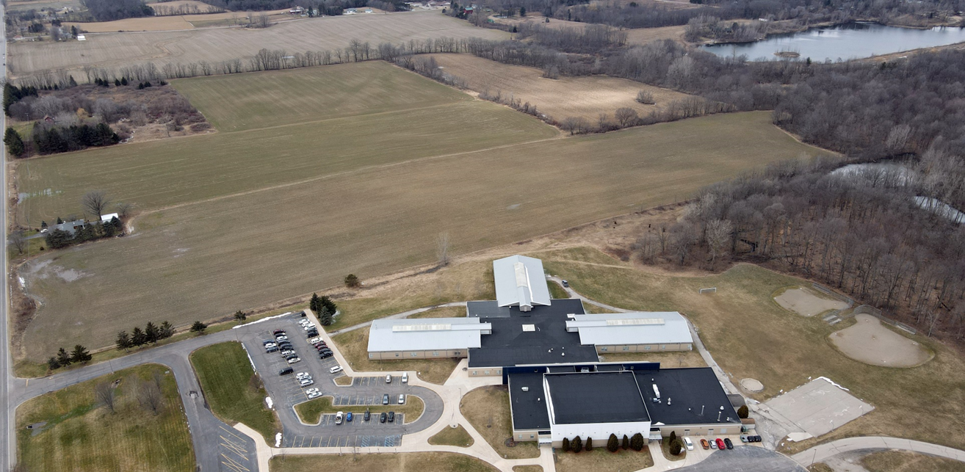
New Elementary Building

Slide 25
In Summary... Importance of 2023 Bond
The Board of Education believes the 2023 Bond will benefit students and the community in a variety of ways, including:
Improving environmental quality and operational efficiency by upgrading outdated building systems/finishes and improving bus transportation throughout the District
Providing safe and secure building entrances
Supporting student success with school facilities that engage students and promote a dynamic, collaborative, and stimulating atmosphere
Creating a more unified Lakewood community through the expansion of our main campus

Slide 26
Scheduled Engagements
School Presentations
Lakewood Elementary School – May 22
Lakewood Early Childhood Center – May 24
Lakewood Middle School – May 24
Lakewood High School – May 24
Community Engagements
Sunfield Township Hall at 7 p.m. on May 31
Lakewood Early Childhood Center Gymnasium
at 7 p.m. on June 1
Clarksville Village Office at 7 p.m. on June 7
Lake Odessa Library at 7 p.m. on June 8
Ongoing Efforts
Project Steering Committee Meeting at 7 p.m. on May 30
Weekly Meeting with
Bond Partners
Weekly meeting with
Campaign Leaders

Slide 27
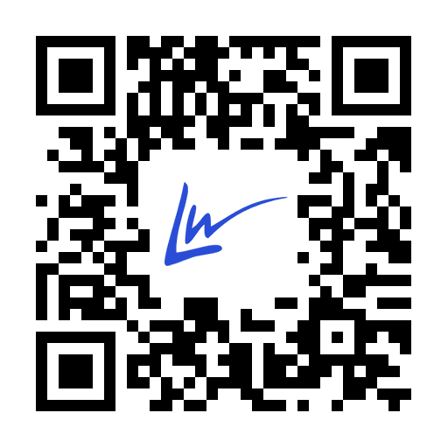
For More Information
Please visit the District’s website at lakewoodps.org/bond
Email your questions about the proposal to: duitsj@lakewoodps.org

Slide 28
Thank you!
Questions?

